Slide 1
MPS Planning Tool
Awesomeness in store

Slide 2
Slide summary
Slide 3-6 Files to link
Slide 7 layout
Slide 8 software requirements
Slide 9 comments section
Slide 10 automatic email alerts
Slide 11 current mps carry over

Slide 3
Files to Link Over view
PFEP/PFEC ☺
Creation and implementation
Fluctuation Report/Tab
Create or use current?
CML
BOM
Lead Time
Idle Inventory
Sales Forecast Report
Launches
Closeouts
Program details
CSM/IHS

Slide 4
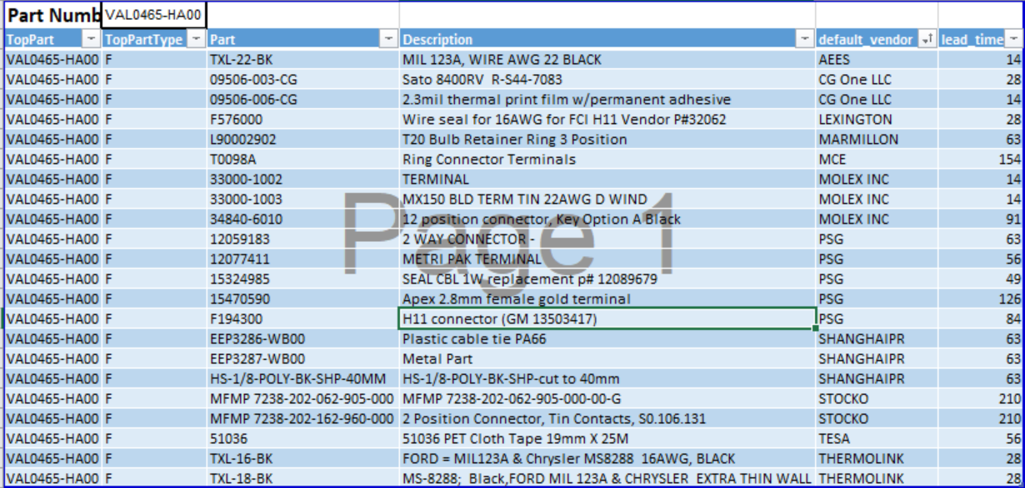
Files to Link BOM
As pulled from EEH monitor
Tab to see the BOM
Add section to the BOM that included where used and if unique (% of usage)

Slide 5
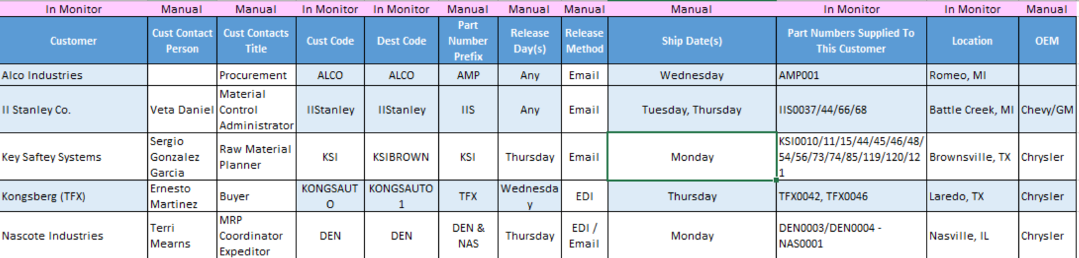
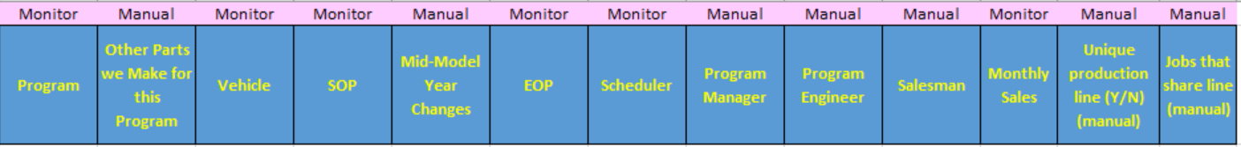
Files To Link PFEP/PFEC example

Slide 6
Other Files to Link
Sales Forecast Report
Sales Report Evision
http://evision/empireweb/executivesalessummary.aspx
Closeouts
..\Measurables\Close Outs
Program Manager Weekly Reports
T:\ED\2018\Weekly Reports
Launches
..\Measurables\Launches\Program Launches - Master Report - February 2018.xls
CSM/HIS
..\..\..\CSM Data\2018\2018-02
Idle Inventory
..\Measurables\Idle Inventory
Lead Time
New MPS\EXCEPTION LONGESTLT example.xlsx
CML
New MPS\CML example.XLSX
Release Fluctuation Report
New MPS\Release Fluctuation.xlsx

Slide 7
Layout
Color Coded with Legend
Weeks on Hand
Under 1 week: Red
1-2 weeks: Green
2-3: Yellow
3+: Red
Capacity (over/under)- Highlighted Cell Blocks
Over/Under-Orange
Within- Green
Longest Lead time- Highlighted Cell Block (Blue)
Holiday Block- Highlighted Cell Block (Taupe)
EOP/SOP
Countdown 1-6 weeks: Purple
EOP/SOP week: Pink
In Header- Empire Blue or keep the same as current MPS
EAU
Capacity
Quality- On hold
Number in Red
Horizontal view- please ☺

Slide 8
Software Requirements
Automatic Calculations
CSM (IHS) data divided by week, software to calculate forecast-future orders
Past averages, for planning off the page
Averages (Weeks on Hand)
Release Fluctuations, week over week
Cause and effect of changes
Exceptions caused by changes
Filter by program and parts that share a line
Plan simultaneously
Database to store previous weeks detail (snapshot)
Non remote access
Live Detail- refreshable
SOP data timetable (reverse closeout structure)
Enter part number “need to start planning alert
Award Emails
Sharable between teams- EEH and EEI
Data Integrity from Monitor/Files
Close out Information EOP
Launch SOP
Click and View Pop-ups
Week over Week Fluctuations
Risk factor
BOM
Customer detail

Slide 9
Comments Section
PO confirmation auto download to the report as a “suggestion” column. They do not have the ability to change or alter MPS
New MPS\PO Confirmations Example.xlsx
Comments from EEH included in the Pop up notes section
Pop up window for a notes section
Running notes, stores by date
Go back and look at, includes all notes from eeh and eei. Remove the need to search through emails for information
Examples
“noticed drop/increase in demand”
“capacity constraints”
“planned per Ken/Cindy Direction”
“raw material issue, CML”

Slide 10
Automatic Email Alerts
Empire to Customer
Release fluctuation
“empire has noticed “x” fluctuation. The estimated cost “x” amount”
Draft to be created by scheduling team
SOP award emails (currently available need to add schedulers)
Detail added to MPS
Closeout notice
“This program is currently set to close out “x” date, please confirm
Draft to be created by scheduling team
Auto Email at the End of Planning
Post Planning report
List of automatic Emails that were sent
Any Parts not planned
Flag issues- capacity/eau
Notes print out
+/- 25% fluctuation
Troy to Plant
Materials Analysis for Fluctuation
Automatic request when fluctuation has surpassed set percentages (TBD)
Planning has been completed alert
Plant to Troy
SOP Alerts
“This part is set to launch at “x” date, Longest lead time is “x”, Quoted EAU is”
Planning under Lead time
“the longest lead time is “x” weeks, we noticed you are planning at “x” weeks
Capacity
“this part is over capacity”
PO confirmation – ready to plan
“file has been uploaded”

Slide 11
Carry Over from Current MPS
New MPS\~$Shortcut MPS Master version 09-08-17.xlsm
Ship History Report
Close out details
EEH open orders Tab?
Auto calculate Weeks on hand
Holiday weeks
Ability to Export
EVERYTHING from the Master Sheet

